Slide 1
SAP BTP Extension Suite Training
Day 13
Anubhav Oberoy
www.AnubhavTrainings.com
Follow excellence with sheer passion

Slide 2


DISCLAIMER
The training content and delivery of this presentation is confidential, and cannot be recorded, or copied and distributed to any third party, without the written consent of Anubhav Trainings

Slide 3
Agenda – Day 13
01
Serverless Fiori App
02
Clean Core
03
Use cases for Clean Core

Slide 4






















Server Less Fiori App

Slide 5
















































Slide 6























































Slide 7
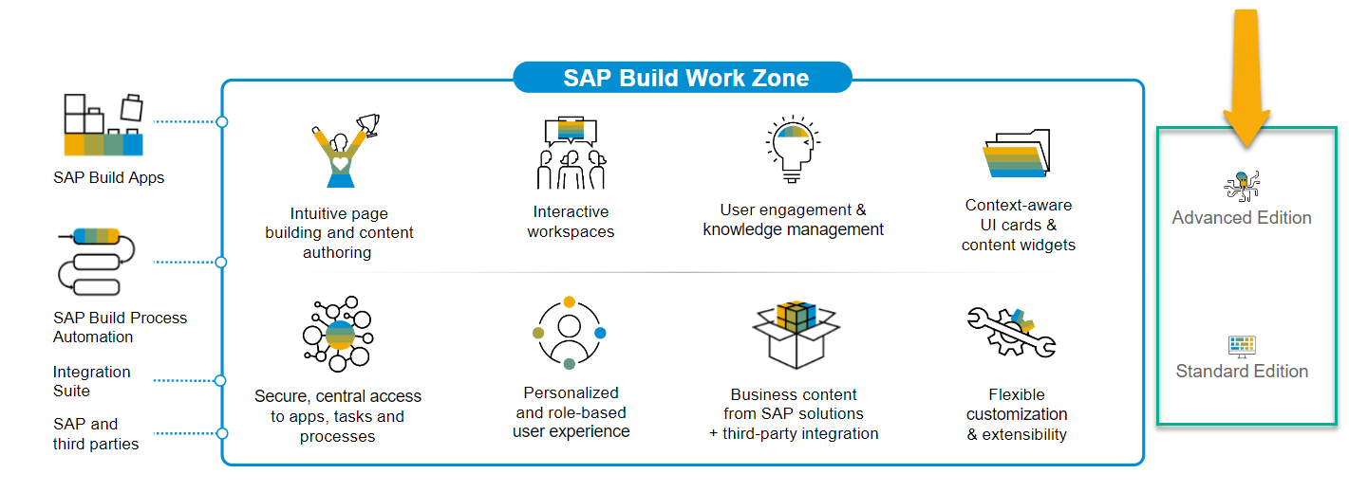
SAP Build Work Zone?
SAP Build Work Zone, advanced edition is a powerful SAP Business Technology Platform service that consists of several components
SAP Launchpad Services is now called SAP Build Work Zone, Standard SAP Work Zone is now called SAP Build Work Zone, Advanced

Slide 8

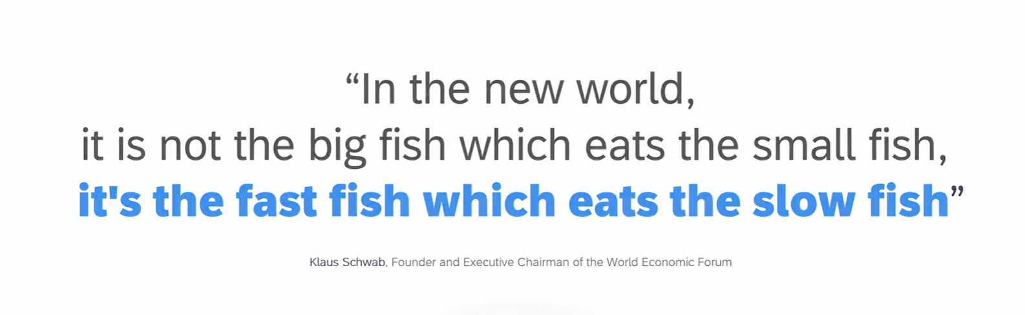
11
www.anubhavtrainings.com

Slide 9
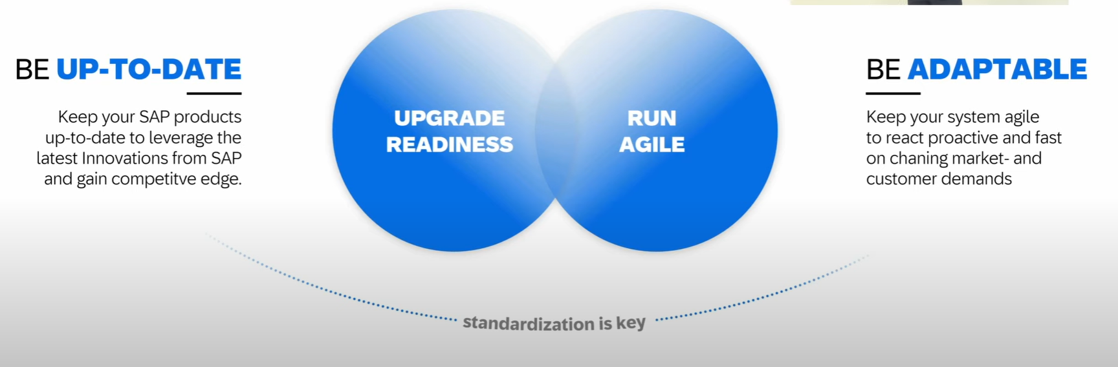
How to be Fast
11
www.anubhavtrainings.com

Slide 10
Clean Core
Clean means up-to-date, documented, unmodified, consistent, efficient and upgrade ready.
S/4HANA Cloud Private Edition => S/4HANA On-premise – GUI Access, Full Control on system, upgrade when customer want, postpone upgrades, SPRO Access, Full access to system code like ECC – 85-90%
S/4HANA Cloud Public Edition => Shared environment, Infra is owned by SAP, not have full control and code, No SAPGUI access, only through browser, Force upgrade (always up to date) -10~15%
Capabilities of clean core depend on Software stack.
Bundle for Rise/Grow with SAP – ERP (Core S/4HANA), BTP (BTPEA), SAC, DS…
11
www.anubhavtrainings.com

Slide 11
Benefits
Access to Innovation – all the latest S/4HANA features can be accessed faster because since you don’t have dependency on custom code, you can upgrade in short time, agile to decide. SAP partners can offer upgrade at fix price.
Upgrade Simplicity – You can apply upgrades stress free.
Lower TCO – Since we follow clean core, we actually use upgrade safe APIs to develop our custom apps. This remains stable release-on-release.
Enhanced security – secure your data and applications which are exposed in cloud.
Improved performance – core is clean, it doesn’t have to interact with lots of custom code, store custom code hence increase the speed.
Data Simplification – which data is privates, which data is public.
11
www.anubhavtrainings.com

Slide 12
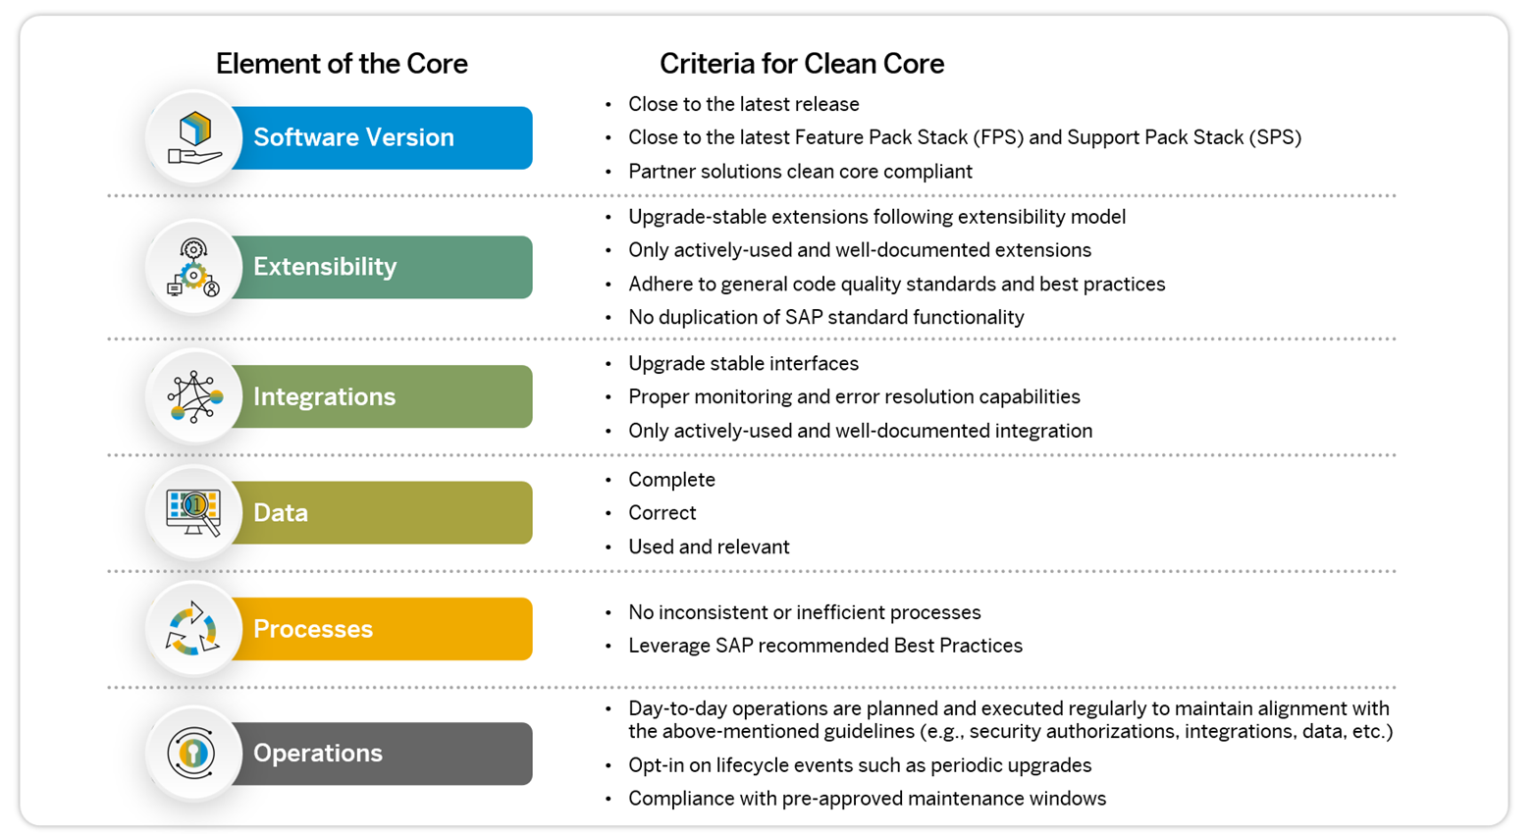
Elements of Clean Core
11
www.anubhavtrainings.com

Slide 13
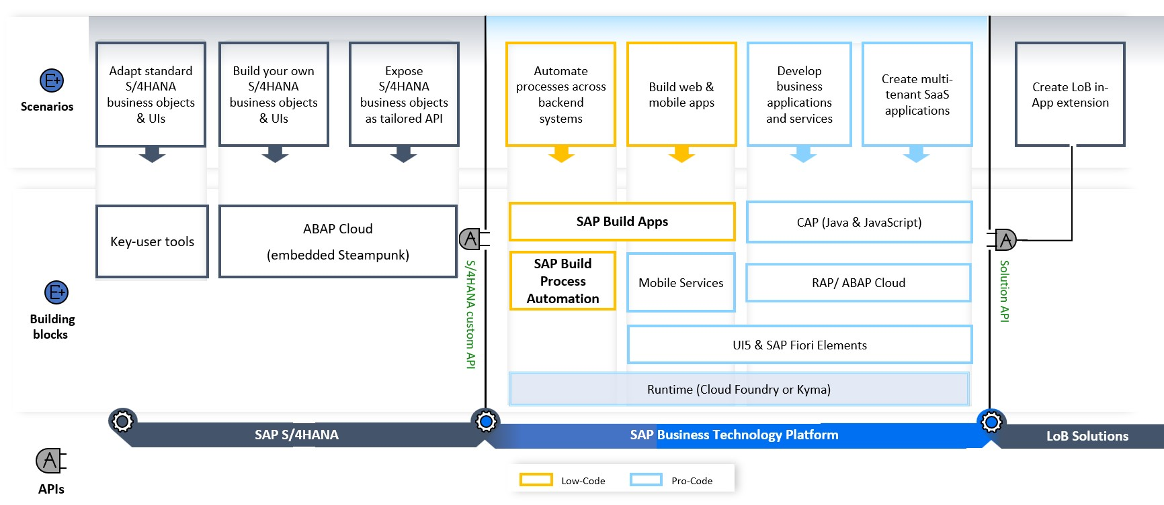
High Level Guidence
<content>
https://youtu.be/n0oS1eiOWU0
11
www.anubhavtrainings.com

Slide 14
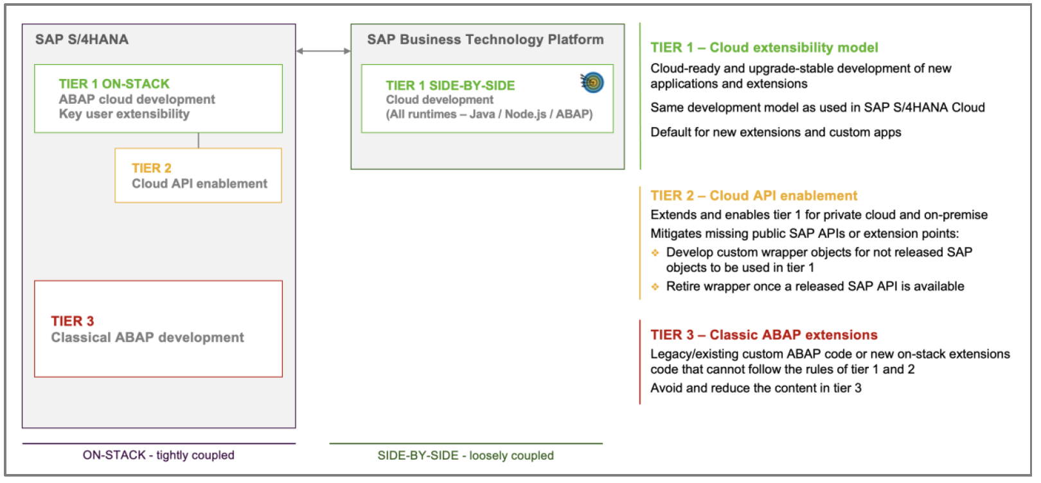
SAP Extensibility Model – Tier 1,2,3
11
www.anubhavtrainings.com

Slide 15
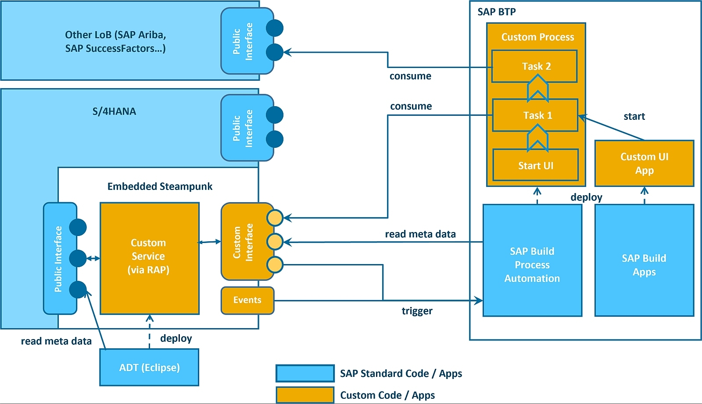
Detailed Journey
11
www.anubhavtrainings.com

Slide 16
Scenario 2:
Own Fiori App
SAP or Non SAP API OData which we want to reuse
Android App
SAP UI5 App
CAPM App
Middleware
Data manipulation, enrichment, Security, automation, movement, proxy
HANA

Slide 17
Hands on: Initialize CAPM Extension
Create a new cap project with cds init
Install the node module @sap-cloud-sdk/generator and @sap-cloud-sdk/odata-v2 as dev dependencies
Drag drop edmx file downloaded from API hub and perform TRANSPILE is VERY IMPORANT
npx generate-odata-client --transpile --input resources/service-specs --outputDir src/generated
Copy src folder inside srv so packaging can be done
Create a new folder service-spec, and cds watch, after that drag drop the edmx file of our service to the folder. It will create external folder
Add a new CatalogService.cds and CatalogService.js
S4HANA cloud sdk is SAP’s portfolio of all the type safe API (node modules) to communicate to SAP APIs.
Code - https://github.com/soyuztechnologies/BTP_Architect_CLD200/tree/master/Day%2015/s4hanaextensions
Add the configuration to test our api locally – credentials
cf create-service xsuaa application myxsuaa
cf create-service-key myxsuaa myxsuaa-key
cds bind --to myxsuaa:myxsuaa-key cds run --profile hybrid
Repeat the same steps for the destination service

Slide 18
@sap-cloud-sdk/generator
To generate code to call business API automatically from CAP to S/4HANA
JS code to call the API
Edmx file

Slide 19
GUI
S/4HANA OP
odata
cds
IRPA
Build Automation
CaI
Data intelligence
SAP Analytics Cloud
API
Browser
S/4HANA Cloud
In-app extension

Slide 22

What We Did
Let’s Summarize

Slide 23

www.anubhavtrainings.com
Thank You
End of Day 13

Slide 24


We’re committed to empower you to be
#FutureReady
through powerful training solutions.
We build the workforce of the future.
260+
Corporate Clients
60,000+
Learners Trained
26000+
Learners Placed
FREE WEBINARS
Sign up for free webinars with industry experts every fortnight!
Enroll Now!
Contact us today!
https://anubhavtrainings.com

